Slide 1

What Counts as Good Evidence?
Principles for evidence-informed practice
Dr Tom Perry, Assistant Professor
Department for Education Studies, University of Warwick
tom.perry@warwick.ac.uk @TWPerry1
Notes:
Thanks for joining
My name, university Warwick, lead the research methods for masters students, conduct research
At the heart of what I do supporting people to do research and to use research
Really excited, Me local researchED, 2nd time speaking
My talk today is...

Slide 2


Q. What counts as good evidence?
For doing research
  Collect and analyse data/evidence
For using research?
Notes:
The guiding question for this talk is…
Where might we look to answer this? To what body knowledge? Maybe I would say this... RM
But I am not saying everyone should read research methods textbooks, or take come and take my master’s research methods module…
But that there are powerful ideas in RM that evidence informed educators can use when improving schools.
Makes sense, doing research... Rm
But what I want to suggest today, is that... RM important for using research.
Cake/bake
They do, To Some extent.A level of. Research literacy – professionalsmi. But not everyone, and not everything in rm
But what? So that’s what I want to explore. How much RM knowledge is needed for EIP? What kind? What does it tell us?

Slide 3
Action research
Bias
Causation
Comparison group
Confidence intervals
Confounding
Control
Correlation
Criticality
Distributions
Effect sizes
Ethics
Evaluation
Evidence
Experiments
Generalisation
Hypothesis testing
Implementation
Longitudinal
Measurement error
Meta-analysis
Pragmatism
Qualitative
Quantitative
RCTs
Reasoning approaches
Referencing
Reliability
Replication
Sampling
Searching
Standardisation
Statistics
Systematic review
Theory
Translation
Triangulation
Validity
Notes:
But what?
Scurry off to my research methods text books/resources/teaching folder
I spent a lot of time staring at this list (which is massively reduced)
Looking for something that:
Is a powerful concept that can be shared easily
One that reveals something about education and the role of evidence in understanding and improving it

Slide 4
Three Areas
Evidence
Replication
Translation/ Implementation
Correlation
Bias and Confounding
Reliability
Distributions
Pragmatism
Hypothesis testing
Validity
Evidence from trials
Data and Progress measures
Evaluation and enquiry

Slide 5
1. Evidence from Trials

Slide 6
Evidence

Slide 7
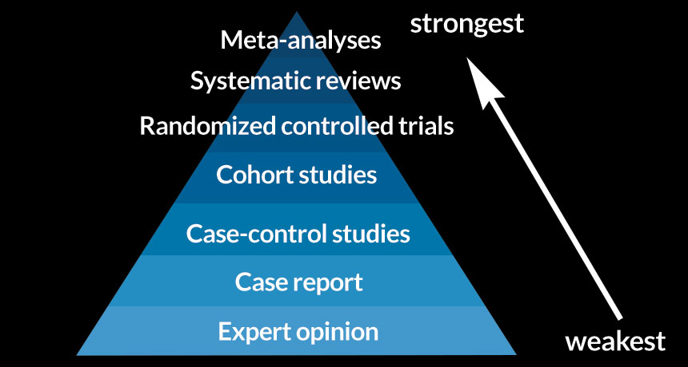
Hierarchy of Evidence
(nb. not everyone agrees with this!)
Notes:
Expert opinion is usually bottom of these

Slide 8
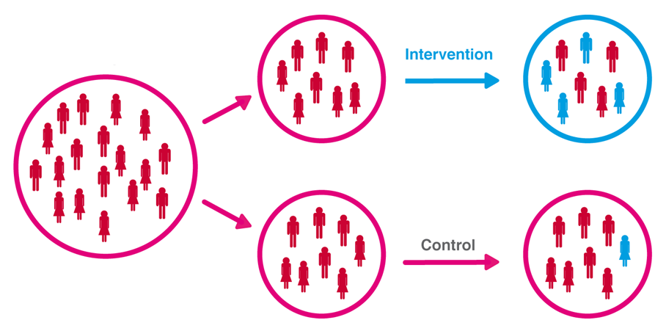

Randomised controlled trial

Slide 9
Hierarchy of Evidence
(nb. not everyone agrees with this!)
Notes:
Expert opinion is usually bottom of these

Slide 10
Systematic Reviews
“…in essence a systematic review is simple: instead of just mooching through the research literature, consciously or unconsciously picking out papers here and there that support your pre-existing beliefs, you take a scientific, systematic approach to the very process of looking for scientific evidence, ensuring that your evidence is as complete and representative as possible of all the research that has ever been done.”
(Ben Goldacre, 2008)

Slide 11
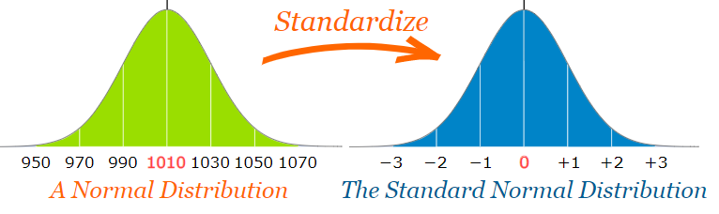

Slide 12
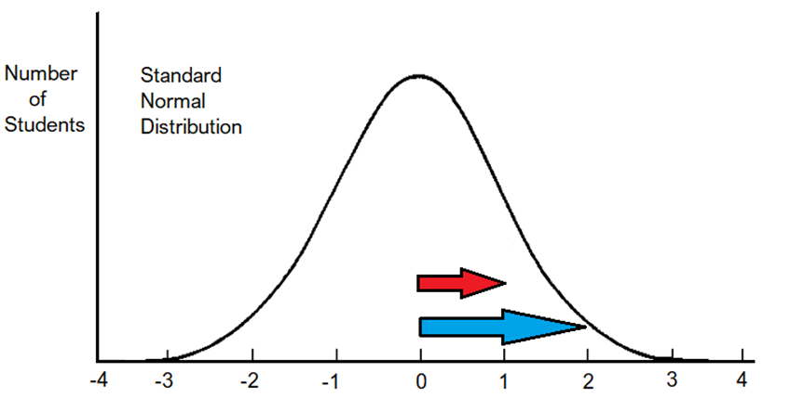
Effect Sizes
When standardised,
impact scores can
be compared on a
common scale

Slide 13
Hierarchy of Evidence
(nb. not everyone agrees with this!)
Notes:
Expert opinion is usually bottom of these

Slide 14
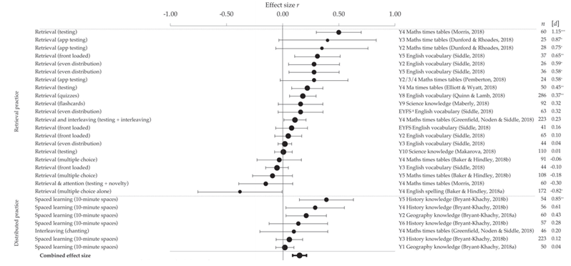
Meta-analysis
Source: https://doi.org/10.1111/mbe.12243

Slide 15
Hierarchy of Evidence
(nb. not everyone agrees with this!)
Notes:
Expert opinion is usually bottom of these

Slide 16
Where to find good ‘what works’ research:
Education Endowment Foundation:
Teaching and Learning Toolkit (based on meta-analysis)
Evidence Reviews
Guidance reports
Also see:
Hattie - https://www.visiblelearningmetax.com/
(summarised here).
IES - https://ies.ed.gov/ncee/wwc/
Notes:
Institute for education sciences

Slide 17
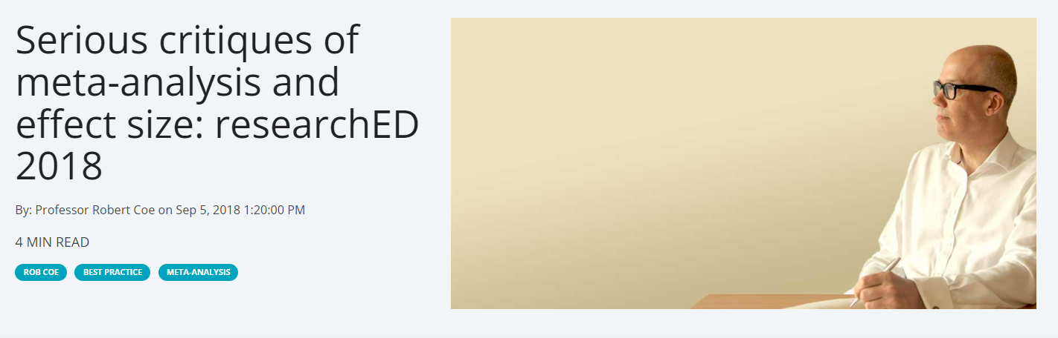
https://www.cem.org/blog/serious-critiques-of-meta-analysis-and-effect-size-researched-2018

Slide 18
Replication

Slide 19
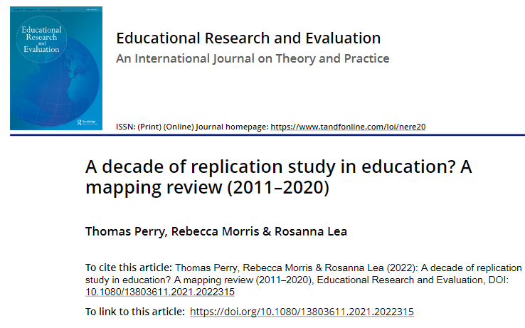

How many
education
studies are
replications?
0.2%
(1 in every 500)
https://www.tandfonline.com/doi/full/10.1080/13803611.2021.2022315

Slide 20

Teacher and School-Led Research (Option 2)
https://www.educationdevelopmenttrust.com/our-research-and-insights/research/teacherworkload-reduction-research
Notes:
https://www.educationdevelopmenttrust.com/our-research-and-insights/research/teacher-workload-reduction-research

Slide 21
Translation and Implementation

Slide 22
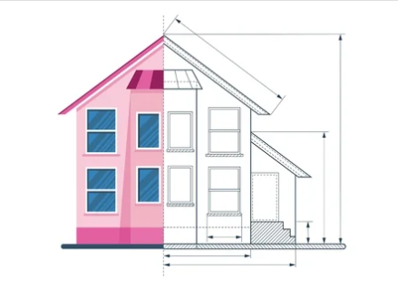
Implementation

Slide 23
Using Evidence
Translation
Retrieval works (i.e., strengthens memory)
Retrieval practice works
… in specific subjects/age ranges
… using specific T&L activities (e.g., quizzing)
… for specific learning objectives/content
… with varying conditions:
  Teacher experience and expertise
  Learner prior knowledge
  Learner motivation
Specific lessons
Specific moments with specific pupils/ideas/questions/misconceptions
Generalised
Generalised
Producing Evidence
Contextualised
Contextualised
Notes:
Concrete – abstract
Practice to principles
Contextualised to generalised

Slide 24


Integration

Slide 25
Cognitive Science
Education Science
+
Memory
Attention
Perception
Thought
Teaching/
Teachers
Learning/
Learners
Curriculum
Leadership/ Organisation

Slide 26
2. Data and Progress Measures

Slide 27
Correlation

Slide 28
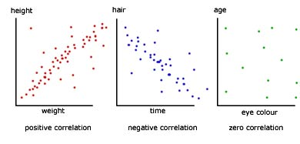
Correlation

Slide 29
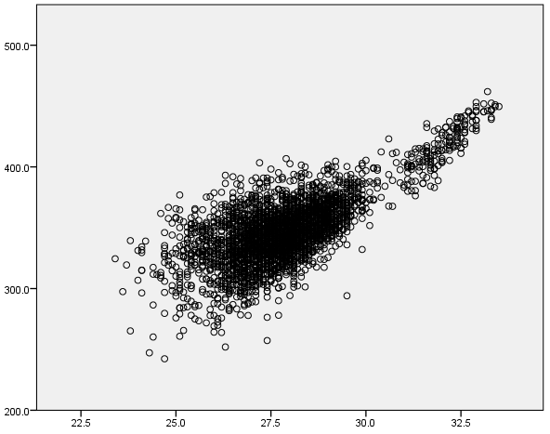
Secondary schools
Average
Key Stage 4 Scores
Average Key Stage 2 Scores

Slide 30

Correlation vs. Causation

Slide 31
Bias and Confounding
A systematic distortion
Alternative explanation
Notes:
General rule – in your favour
Politicians

Slide 32
Considering alternative explanations
‘Non-School’ Factors
Prior Attainment
Gender
Month of Birth
Disadvantage (FSM/IDACI)
Special Educational Needs (SEN)
Pupil Mobility
English Language (EAL)
Ethnicity
… and lots of things we can’t or don’t measure (e.g. parental support and education)
‘School’ Factors
Quality of Teaching
Quality of Leadership
Facilities / resources
Quality of Curriculum
?
Just a few factors
account for
over 1/3 of
Progress 8 variation!
Perry, T. (2016). English Value-Added Measures: Examining the Limitations of School Performance Measurement. British Educational Research Journal, 42(6), 1056-1080. doi:10.1002/berj.3247

Slide 33
Reliability

Slide 34

Reliability (i.e., stability) (at school level)
Some (representative) views from the research literature…
Value-added (VA) measures (i.e., ‘Progress’)
  ‘highly unstable’
  effectiveness of schools ‘indeterminable’
  ‘long-standing problem’
CVA (contextualised value-added) are…
  ‘meaningless’
  ‘only slightly more useful in school choice than a school’s composition’ (average KS2 score)

Slide 35
Distributions

Slide 36
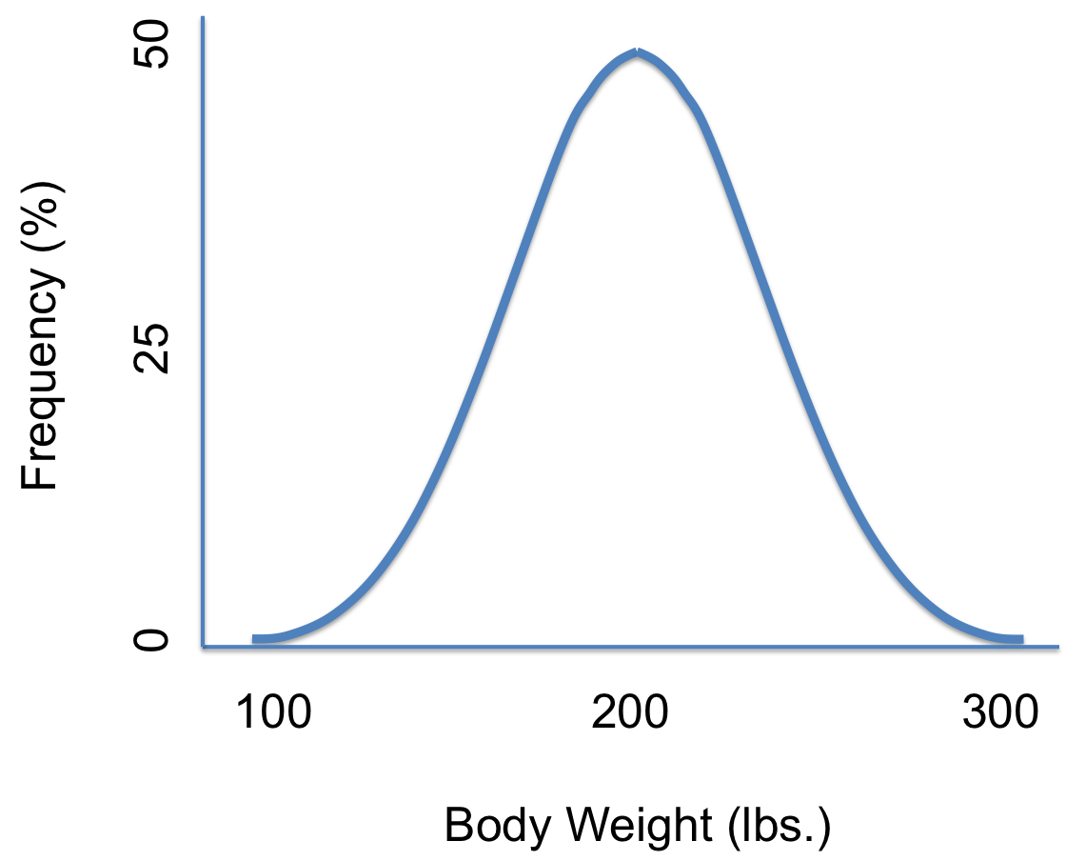

Normal Distribution
Sometimes called a ‘bell curve’

Slide 37
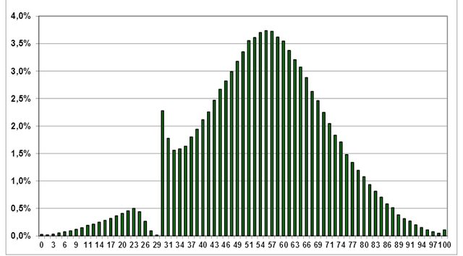
Distributions can tell us a lot…
Polish Matura Results (secondary school exit exam)

Slide 38



What’s in an average?
V. Low
Above
average
V. high

Slide 39
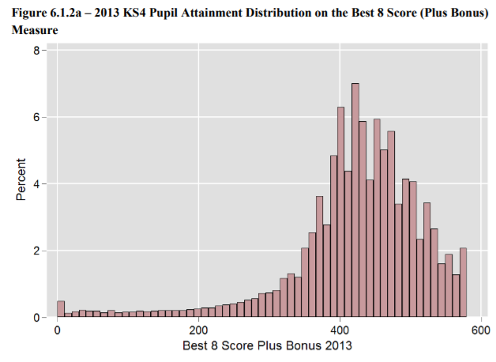

Slide 40
3. Evaluation and Enquiry

Slide 41
Pragmatism
Notes:
Basic/academic and applied
Type o-f research that everyone can do!

Slide 42
Different types of research…
Research is…
‘systematic, self-critical inquiry’, open to public criticism and empirical testing
(Stenhouse, 1981, p. 103)
Notes:
Not just stumbling on/get from exposure – systematic – set out to find out – follow a process to do so
Self-critical – so we are honest with ourselves, and question what we know and do not know based on the evidence we have
You collect and analyse data/evidence to improve understanding

Slide 43
Different types of evidence and theory…
Academic Evidence | Academic Theory
Practical Evidence | Practical Theory (Theory of action)
Cognitivism
Cognitive load
theory
Fading
Breaking-down
problems
Meta-analysis
Case study
Staff discussion
for SEF
Workbooks

Slide 44
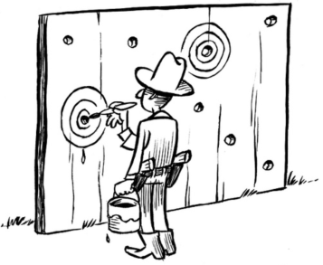
Hypothesis Testing
HARKing
Hypothesising after the results are known
Notes:
Texas sharpshooter fallacy

Slide 45
Validity
Notes:
Validity – accurate, sound, true
A valid measure, a valid conclusion

Slide 46
Trusting claims from research
It feels plausible based on my experience
It comes from an authoritative source (organisation, researcher, colleague, expert)
Some understanding of the methods used and evidence presented, some scrutiny of this
Advanced/critical understanding of the methods used and evidence presented, extensive scrutiny of this
… and how this fits with other evidence

Slide 47

‘on the word of no one’
Notes:
Verification

Slide 48
Evidence-practice gap
Proven
Based
Consistent
Plausible
Tenuous
Contradictory
What the evidence shows
Interpretation and Use

Slide 49





What Needs to be Valid?
Assessment
/ indicator
Data
Interpretation
Use

Slide 50
What Counts as Good Evidence?
Principles for evidence-informed practice
Dr Tom Perry, Assistant Professor
Department for Education Studies, University of Warwick
tom.perry@warwick.ac.uk @TWPerry1

